Slide 1
Empirical Performance Analysis: Set Cover Problem
Comparing Exact (ILP), Heuristic (Greedy), and Metaheuristic (GA, HS) Paradigms
CSC 2400 — Design and Analysis of Algorithms Authors: Matthew Richardson, Ian Phillips, Abdullah Javed
Notes:
Good morning/afternoon. Today our team is presenting an empirical evaluation of four distinct algorithmic paradigms for solving the Unweighted Set Cover Problem.

Slide 2
What is the Set Cover Problem (SCP)?
• Formal Definition: Given universe U = {1, ..., n} and subsets S = {S_1, ..., S_m}, select S' ⊆ S of minimal cardinality such that ⋃ S_j = U.
• Optimization Target: Minimize total subsets picked while ensuring 100% element coverage.
• NP-Hard Complexity: Theoretical worst-case complexity forces a trade-off between exactness and execution time.
• Real-World Applications: Airline crew scheduling, computational biology, cellular tower layout, portfolio optimization.
Notes:
The Set Cover Problem asks what is the fewest number of subsets needed to cover every element in a universe. Because it is NP-hard, finding exact answers becomes exponentially difficult as problem sizes scale.

Slide 3
Research Questions & Hypotheses
• RQ1 (Solution Quality): Do population/pitch-adjustment metaheuristics (GA, HS) consistently find tighter covers than Greedy on sparse benchmark matrices?
➜ Hypothesis: Yes. Greedy is myopic and susceptible to local traps; GA and HS utilize stochastic operators to escape local optima.
• RQ2 (Runtime Scalability): How do runtimes scale relative to exact ILP as universe size expands to N = 2048?
➜ Hypothesis: Exact ILP will hit an exponential worst-case runtime wall O(2^m), whereas metaheuristics scale predictably within bounded generation/iteration limits.
Notes:
We framed our investigation around two primary questions: can stochastic metaheuristics beat local myopic traps that fool greedy choices, and where exactly does exact Integer Linear Programming become intractable?

Slide 4
Theoretical & Computational Complexity
• ILP Exact Solver (Branch-and-Bound / Cuts):
- Time Complexity: O(2^m) worst-case | Traversal: Global search via continuous Simplex relaxation
• Greedy Approximation Heuristic:
- Time Complexity: O(m · n²) | Traversal: Deterministic local myopic reduction
• Genetic Algorithm (GA):
- Time Complexity: O(G · P · m · n) | Traversal: Population evolutionary crossover, mutation & repair
• Harmony Search (HS):
- Time Complexity: O(K · HMS · m) | Traversal: Pitch-adjustment memory consideration search
Notes:
Here we see our four algorithmic paradigms. ILP gives guaranteed mathematical exactness at the cost of potential exponential runtime. Greedy offers ultra-fast execution, while GA and HS bound runtime via generation limits.

Slide 5
Empirical Results: Beasley OR-Library (scp41.txt)
• Benchmark Instance Specs: Universe Size (n) = 200 elements | Subsets (m) = 1,000 candidate subsets
• ILP Exact Solver: 0.0391s runtime | 5 Subsets Utilized | 0.00% Gap (True Mathematical Optimum)
• Harmony Search (HS): 0.0116s runtime | 5 Subsets Utilized | 0.00% Gap (Matched True Optimum)
• Genetic Algorithm (GA): 0.9723s runtime | 5 Subsets Utilized | 0.00% Gap (Matched True Optimum)
• Greedy Heuristic: 0.0000s runtime | 6 Subsets Utilized | +20.00% Optimality Gap (Local Trap)
• Key Finding: Harmony Search matched global optimality while executing ~83x faster than GA.
Notes:
On the standard academic benchmark scp41, the Greedy heuristic got trapped at 6 subsets. Both GA and Harmony Search found the true optimal cover size of 5, but Harmony Search did so in just 11.6 milliseconds.

Slide 6
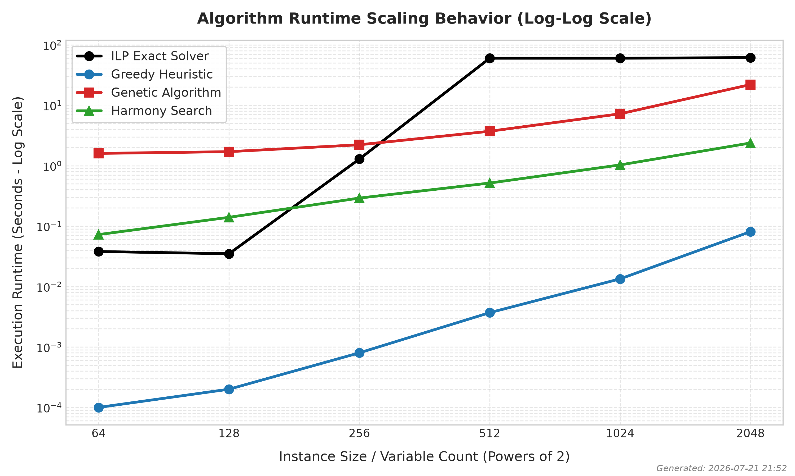
Runtime Scalability: Synthetic Suite (N = 64 → 2048)
• ILP Intractability Ceiling: Solves N ≤ 256 in < 1.5s, but hits 60s timeout at N = 512/1024, becoming intractable at N = 2048.
• Greedy Efficiency: Sub-second runtime across all scales (0.0913s at N = 2048).
• Metaheuristic Bounded Runtime: Bounded by maximum generation limits.
Notes:
Looking at runtime scaling across synthetic datasets, ILP clearly displays its exponential curve, hitting our 60-second safety cutoff at N=512 and failing entirely at N=2048.

Slide 7
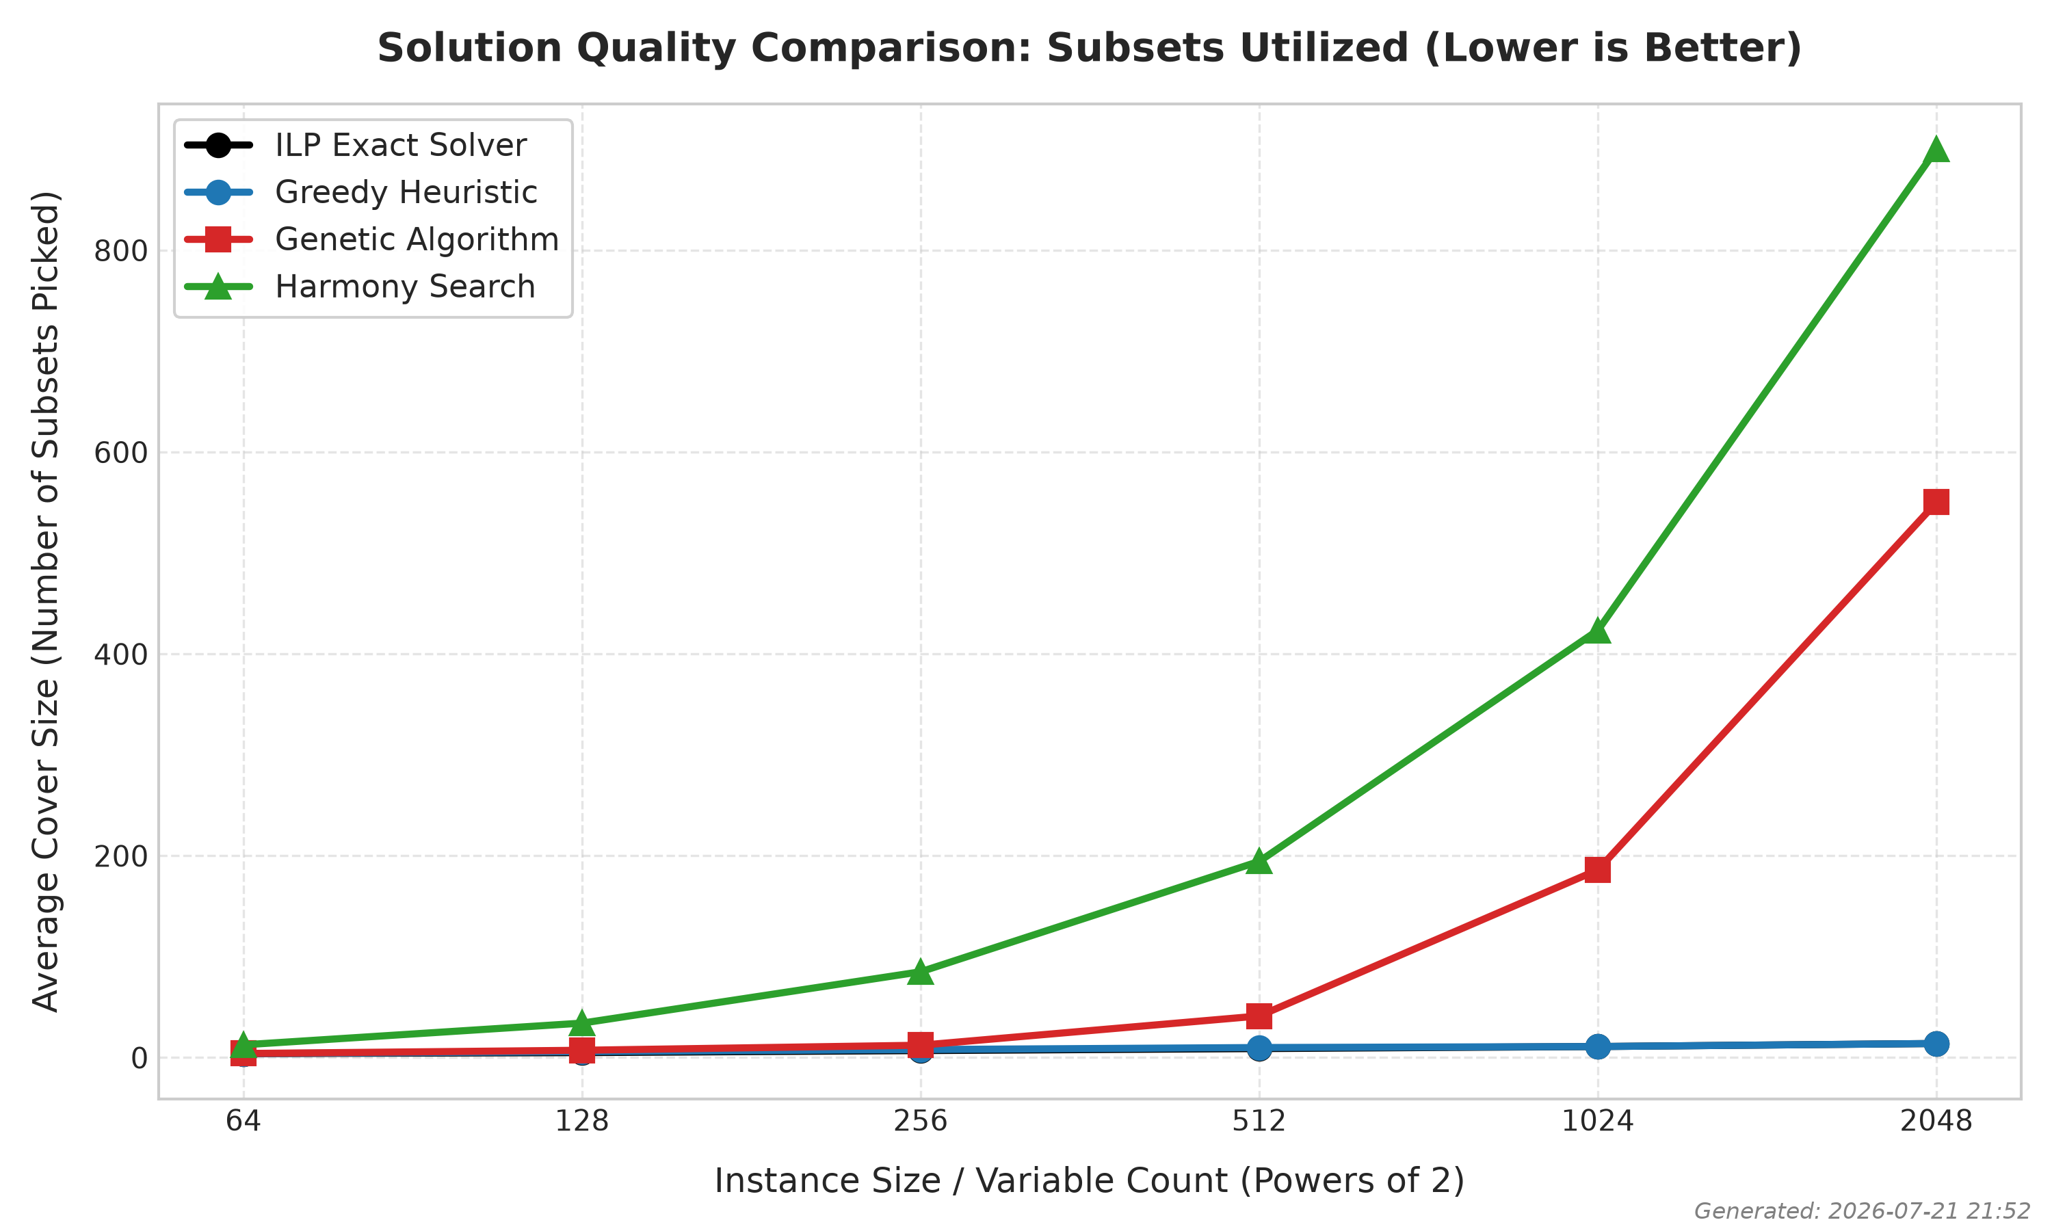
Solution Quality & Search Space Dynamics
• Greedy Dominance on Synthetic Grids: Tracked ILP baseline closely (0.00% - 20.00% gap).
• Metaheuristic Search Explosion: Standard GA/HS without domain-specific repair pick redundant subsets during feasibility enforcement as N grows.
Notes:
Greedy performed exceptionally well on synthetic data, staying right next to the exact baseline. Un-guided GA and HS suffered from search-space explosion during repair phases on dense matrices.

Slide 8
Trade-off Matrix & Paradigm Selection Guide
1. Exact ILP (Branch-and-Bound):
- Best Used For: Small-to-medium instances (N ≤ 256) where true mathematical minimality is required.
- Limitation: Unusable for large-scale real-time engineering systems due to exponential runtime growth.
2. Greedy Approximation Heuristic:
- Best Used For: Dense grids and high-dimensional synthetic systems needing instant execution (< 0.1s).
- Limitation: Vulnerable to local optimization traps on sparse structured benchmarks.
3. Metaheuristics (GA & Harmony Search):
- Best Used For: Complex sparse academic instances (e.g., scp41) where local greedy traps exist.
- Key Takeaway: Harmony Search offers faster convergence and lower memory overhead than GA.
Notes:
To summarize the trade-offs: use ILP when you need 100% exact solutions on small problems; use Greedy for real-time results on massive dense grids; and use Metaheuristics on complex sparse structures where greedy choices fail.

Slide 9
Software Architecture & Academic Compliance
• Modular System Architecture:
- Independent solver modules (`ilp_solver.py`, `greedy_solvers.py`, `genetic_algorithm.py`, `harmony_search.py`).
- Unified pipeline driver (`main.py`) with automated CSV metrics logging and visualization engine (`generate_plots.py`).
• Team Contribution Breakdown:
- Ian Phillips: Core Greedy heuristic logic & data matrix parsing.
- Abdullah Javed: Genetic Algorithm search engine, crossover/mutation, and repair loops.
- Matthew Richardson: Harmony Search, ILP engine integration, benchmark pipeline, and plot generation.
• Generative AI Compliance Statement (TTU Guidelines):
- Utilized Gemini as a pair-programming collaborator for Matplotlib plot styling, token parsers, and proofreading.
- All underlying algorithmic code and experimental verification was authored and validated manually.
Notes:
Our codebase was built with strict modular design in Python. In alignment with TTU academic integrity guidelines, Generative AI was utilized strictly for code formatting, visualization styling, and documentation proofreading.

Slide 10
Conclusion & Q&A Session
• Summary of Key Artifacts:
- Complete empirical benchmark framework covering exact, heuristic, and metaheuristic paradigms.
- Validated performance trade-offs across academic (OR-Library) and synthetic scaling suites.
- Modular, reproducible codebase published to GitHub.
• Project Repository: github.com/matthew-richardson-ai/SetCover_Greedy_ILP_HS_GA_ORLibrary
==================================================================
THANK YOU! ANY QUESTIONS?
==================================================================
Notes:
Thank you for your time! We are now ready for the 5-minute Q&A session.

